Slide 1


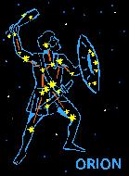
Welcome to Y5/6
Meet the Teacher Meeting
September 2026

Slide 2
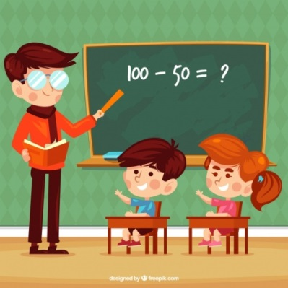

Y5/6 Staff
Lyra
Mrs Hill* (Monday & Tuesday)
Mrs Pople (Wednesday - Friday)
Orion
Mrs Weston (Monday – Wednesday)
Mrs Bennett (Thursday and Friday)
Aquila
Mrs Schofield – Monday – Friday
Teaching Assistants
Mr Percival
Mrs Norman

Slide 3

Topic Overview
Autumn
Born In The USA
Spring
Egyptians
Natural Resources
Summer
Ancient Greece
Place Knowledge

Slide 4

Homework
This will begin week beginning 14th September.
Year 6 SATs books in New Year.

Slide 5
Homework
Spellings
List of words sent home on a Tuesday based on the spelling rule for the week.
Two homework tasks:
Bingo task
Practise the words in sentences
Test on following Monday.

Slide 6
Homework
Reading
Children will be expected to read each week however there is no set number of pages.
There will be no reading log.
A bingo task must be completed each week based on their reading. This must be brought into school on a Tuesday.

Slide 7
Homework
Maths
Times tables
Quickfire – tested weekly
Sumdog task set weekly on a Tuesday linked to in class learning.

Slide 8
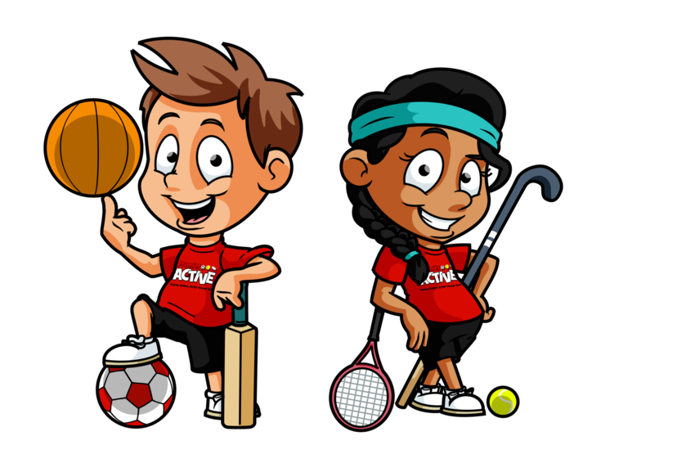

P.E.
Keep your eye on Class Dojo in case of last minute PE day changes.
Due to the timetable of CM Sports not every PPA will include PE.
Autumn 1 PE Days:
Aquila – Monday and Wednesday
Lyra – Monday and Wednesday
Orion – Wednesday and Thursday

Slide 9

Uniform
White tailored shirt
School tie (dark blue with narrow red and yellow diagonal stripes)
Tailored school trousers, skirt or pinafore in mid grey
Navy blue V-neck sweatshirt or sweatshirt cardigan embroidered with school logo
Grey socks or grey tights
White socks (preferably only with summer dresses but can be worn with winter uniform)
Flat, closed black shoes
If a Summer dress is worn, it should be French navy gingham and worn with white socks.
PE Kit
The PE kit should consist of navy P.E. shorts, plain white top and plimsolls/trainers. Children will also require navy blue jogging trousers/leggings and plain navy sweatshirt (not hoodie) for cold weather.
Hair and Jewellery
In the interest of safety, children should not wear jewellery to school.
Exceptions:
medical bracelet/necklace
Small stud earrings are permitted only if the child can independently remove them for PE lessons and put them back in afterwards.
A watch may be worn, but must be removed for PE (No smart watches please)
PLEASE ENSURE ALL UNIFORM IS NAMED CLEARLY

Slide 10
Diary Dates
5th October – Catholic Social Teaching Day
16th November – Year 5 and 6 class liturgies

Slide 11

Questions
If you have any questions, then please feel free to chat to us now or you can always contact us via ClassDojo.

